Slide 1



Analyzing polytomous data using Rasch PCM in R
a simulation study comparing TAM (MML) and eRm (CML)
Scandinavian Applied Measurement Conference 2024
Magnus Johansson, PhD
RISE Research Institutes of Sweden
2024-06-14

Slide 2
Preamble
“A useful outcome of this study is that the figures documenting results can be used to determine statistical power in terms of item parameter precision for Rasch analysis, based on the number of item thresholds estimated, sample size, and targeting.”
Apologies! This has not been completed yet due to a recent family crisis.

Slide 3
Results
TAM has systematic bias in estimating item threshold locations in polytomous data (3-5 response categories, 9 items, n = 20*thresholds)
inflates estimates increasingly as distance from middle threshold increases
results in biased theta estimates (person ability/score/measure)

Slide 4
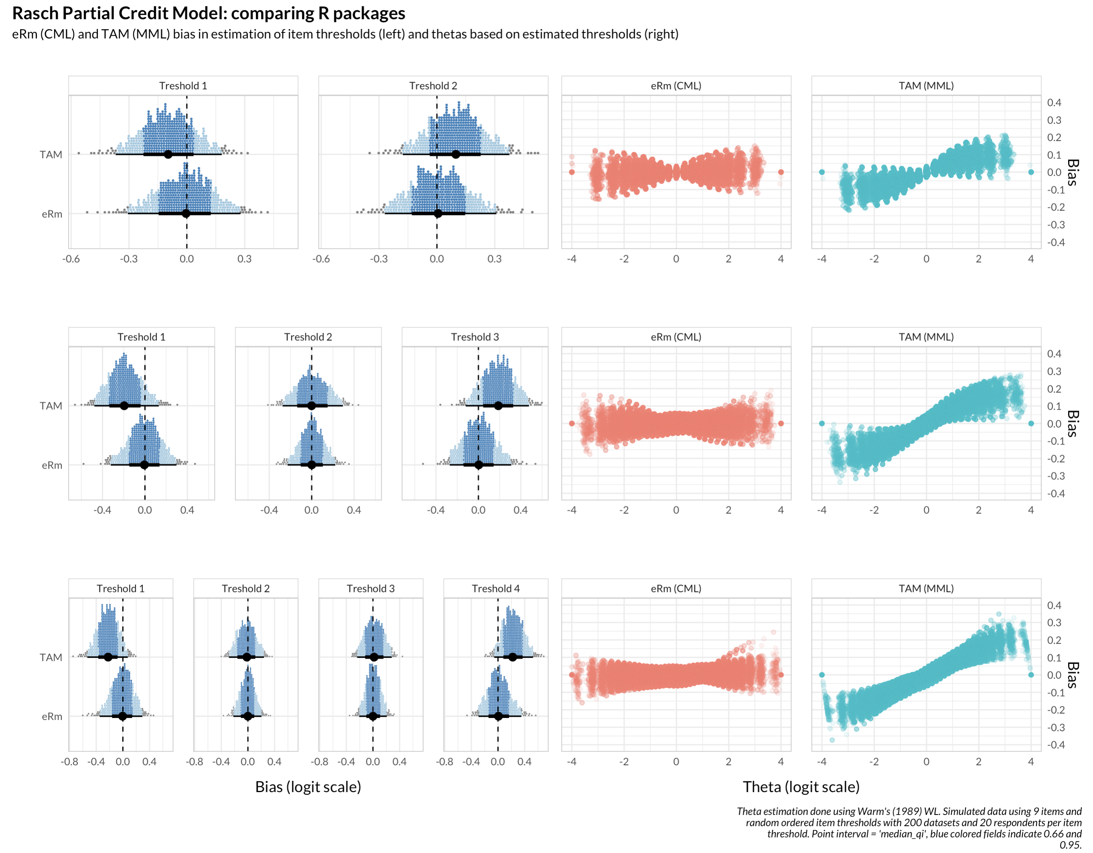
3 response
categories
4 response
categories
5 response
categories
Item threshold estimation
magnus.p.johansson@ri.se

Slide 5
3 response
categories
4 response
categories
5 response
categories
magnus.p.johansson@ri.se

Slide 6
Background
Linacre (2022) claimed that eRm was not suitable for Rasch PCM, based on a vaguely described analysis, recommending TAM instead
My first simulation study focused on average item locations, which produced results that were difficult to understand
particularly the relationship between apparent bias in estimation of thresholds and estimated thetas
I started over, picking things apart and building the simulation study step by step in greater detail
magnus.p.johansson@ri.se

Slide 7
Step 1
One simulated dataset, n = 1200 (good targeting)
9 items, each with 4 response categories
RISE — Research Institutes of Sweden – Magnus Johansson, PhD – magnus.p.johansson@ri.se

Slide 8
The simulation process
Generate distribution of person locations, “input thetas”
Use the generated distribution with a set of pre-defined item threshold parameters to simulate item responses
Estimate!
item threshold locations
thetas/person locations
using either estimated thresholds, or the item thresholds used to simulate the response data

Slide 9
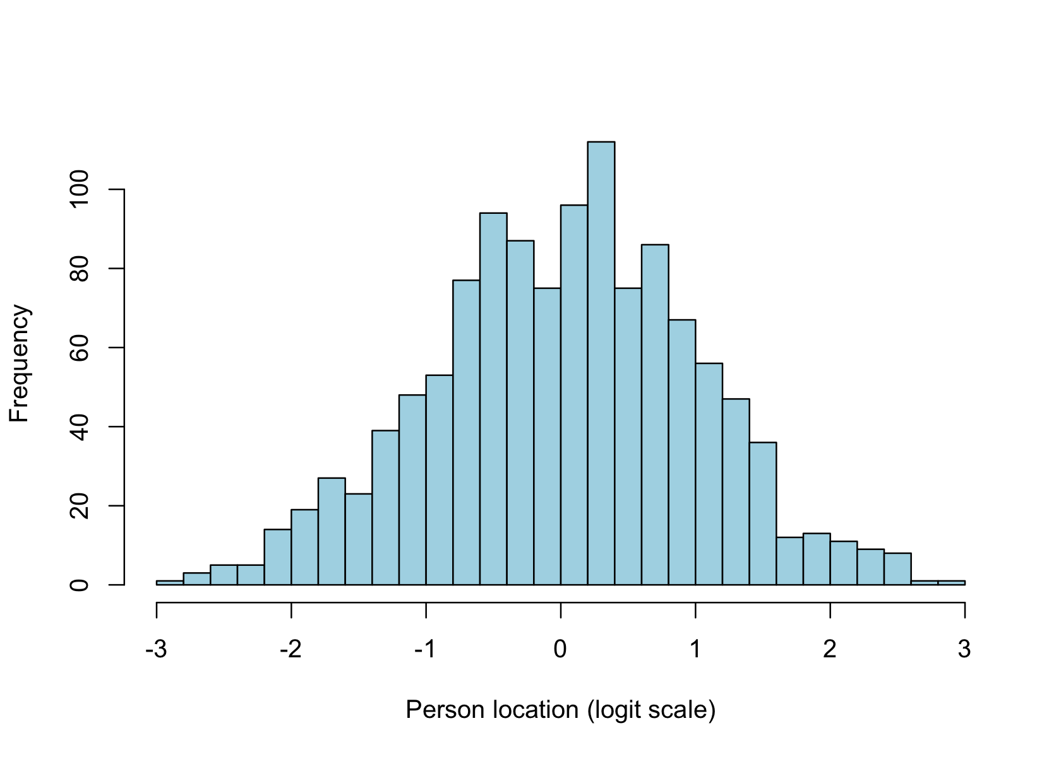
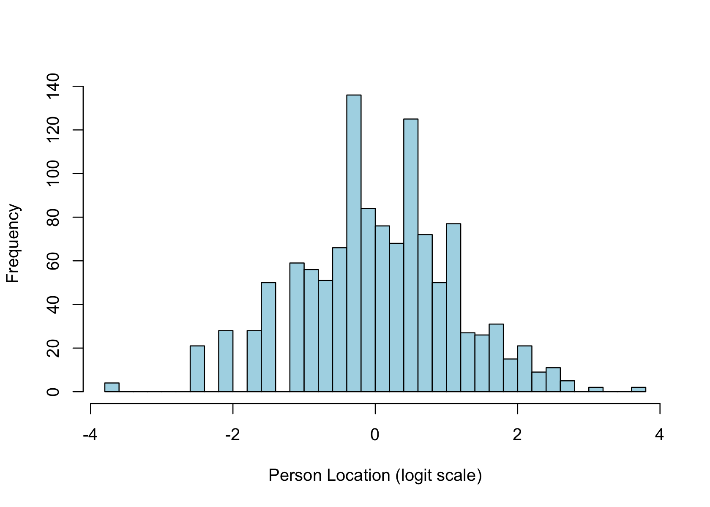
Distribution of simulated
person locations
Distributions of estimated
person locations
magnus.p.johansson@ri.se

Slide 10
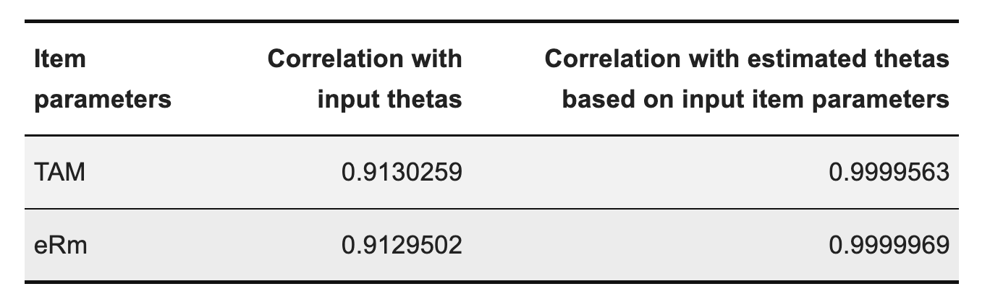
In the simulation, we have “input thetas”, which are the true theta values used
to simulate item responses (based on pre-defined item threshold locations)
Based on the pre-defined item threshold locations we can estimate thetas, to see
how close to the true values we can get. (There is some bias in theta estimation, WL is best overall [-2,2], while ML is less biased at more extreme values, see Kreiner & Christensen, 2012)
We compare this to thetas estimated using the estimated item thresholds.If you evaluate this only by using correlation you may conclude that differences are negligible:
Kreiner, S., & Christensen, K. B. (2012). Person Parameter Estimation and Measurement in Rasch Models. In Rasch Models in Health (pp. 63–78). John Wiley & Sons, Ltd. https://doi.org/10.1002/9781118574454.ch4
magnus.p.johansson@ri.se

Slide 11
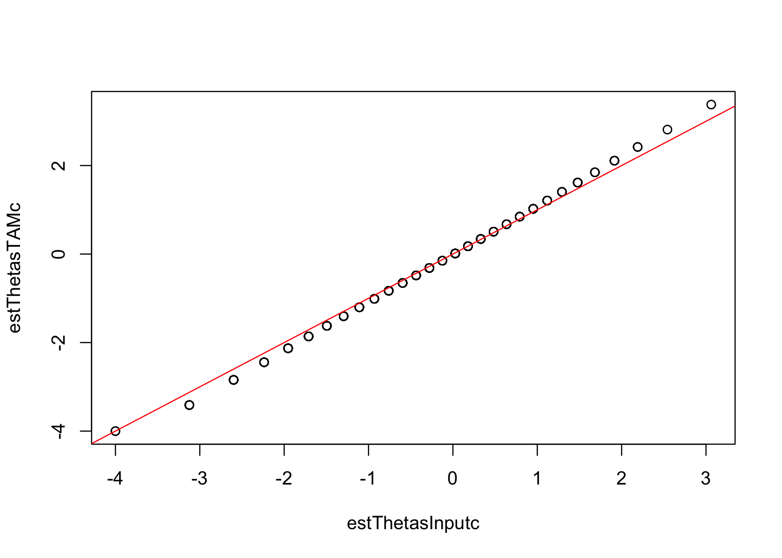
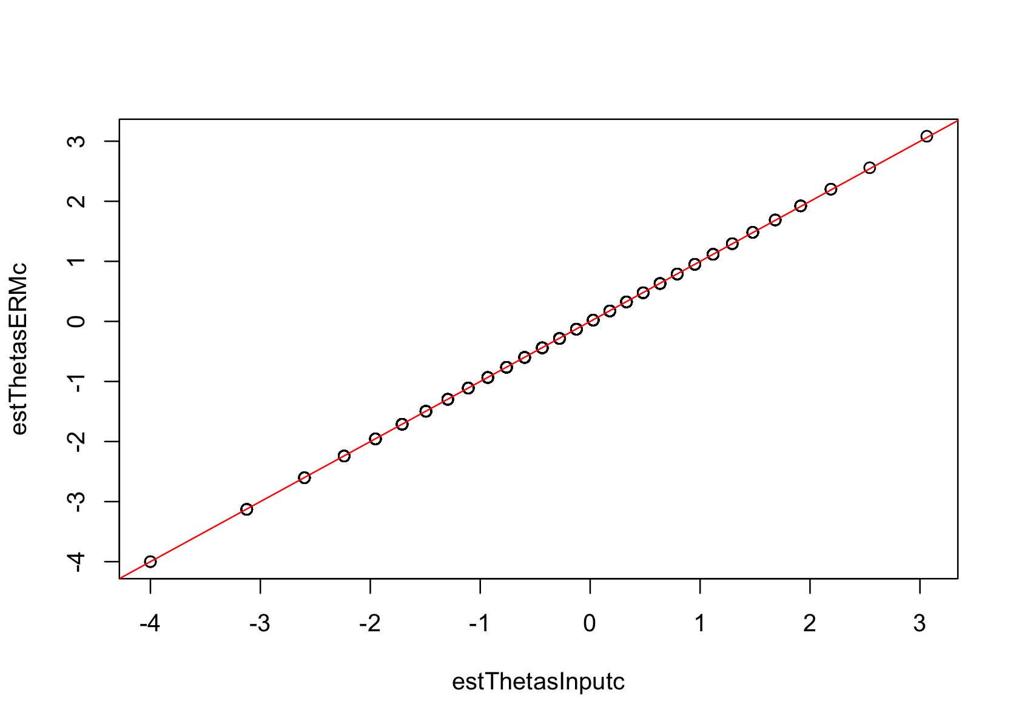
magnus.p.johansson@ri.se
TAM
ALWAYS PLOT YOUR DATA
eRm
Comparing thetas estimated using actual item threshold locations (X-axis) with thetas estimated using estimated item threshold locations (Y-axis)

Slide 12
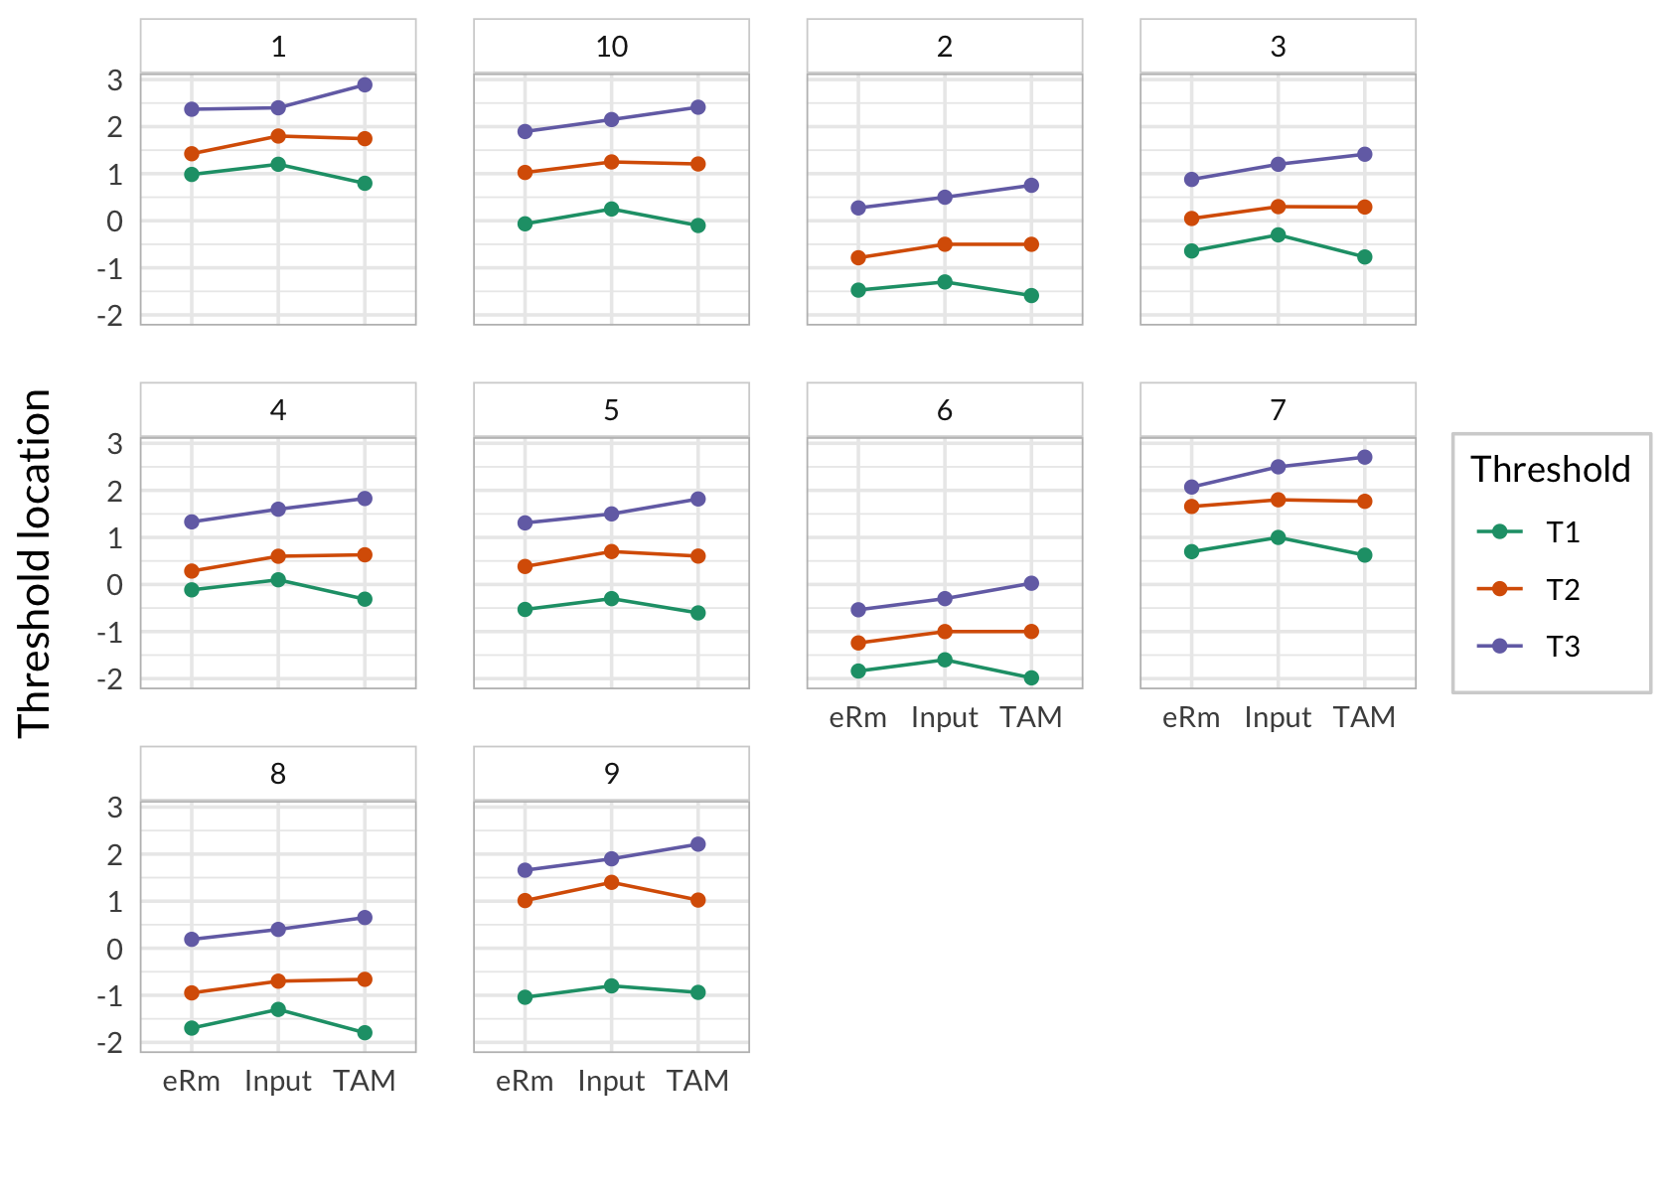
Comparing estimated thresholds (eRm on the left, TAM to the right in each item/box)
magnus.p.johansson@ri.se

Slide 13
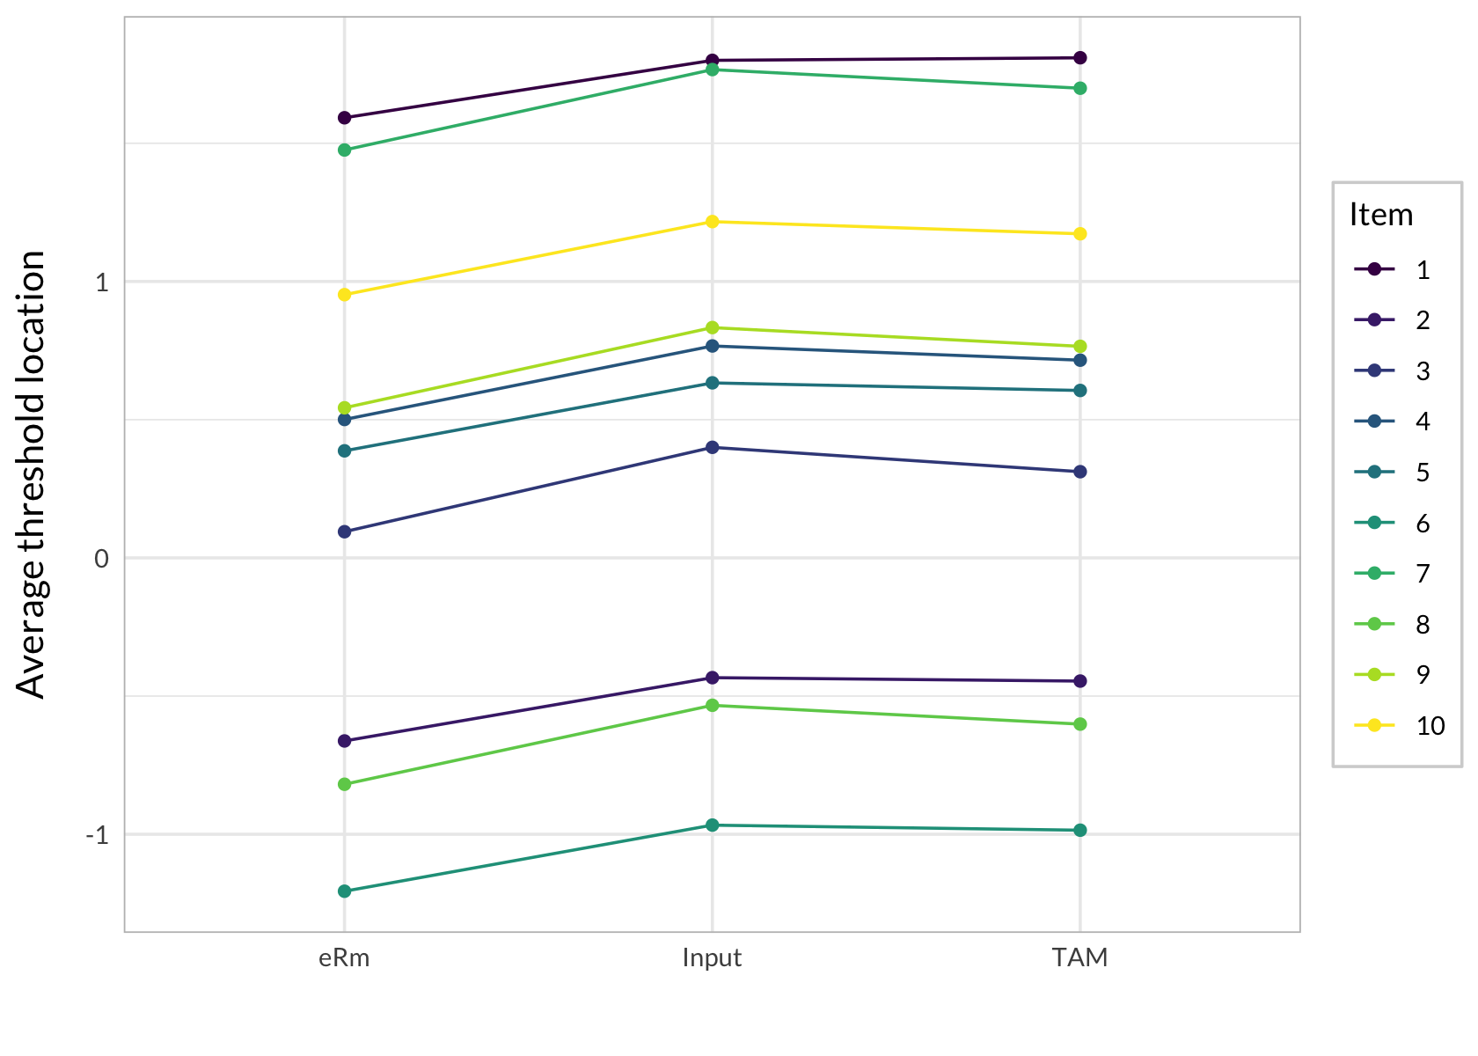
Average item locations
magnus.p.johansson@ri.se

Slide 14
Sum to zero
eRm::PCM() has the option sum0 = TRUE, which is the default setting
but it does not output item thresholds that sum to zero...
manual “centering” (subtract mean) necessary for comparisons
RISE — Research Institutes of Sweden – Magnus Johansson, PhD – magnus.p.johansson@ri.se

Slide 15
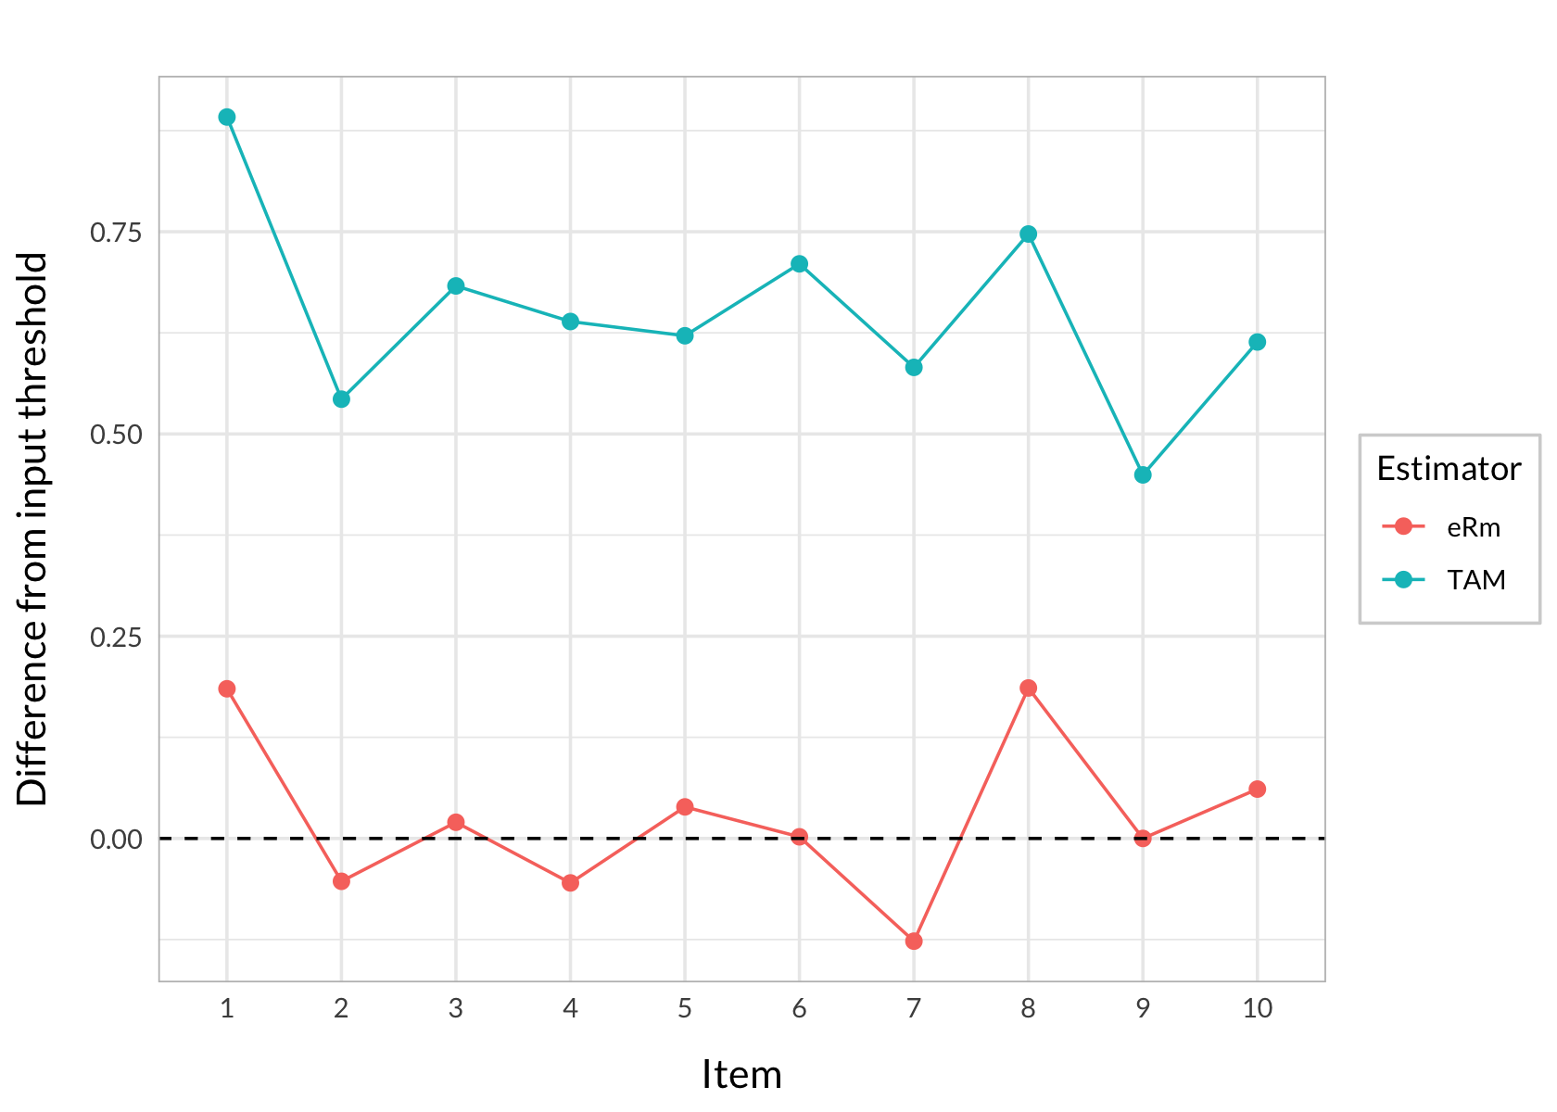
Difference between estimated and actual highest/lowest threshold distance
magnus.p.johansson@ri.se

Slide 16
The simulation study setup
Focus: item threshold estimation bias & how this affects estimation of thetas
Varying parameters: 3,4, & 5 response categories (2-4 thresholds per item)
Item thresholds were sampled randomly from a fixed range, ensuring ordered categories
Well-targeted samples (𝑁(0, 1)) with sample size 20 times total number of thresholds (2 thresholds * 9 items gives 18 * 20 = 360 participants; 3 thresholds = 540; 4 thresholds = 720)
200 samples/datasets generated per condition
RISE — Research Institutes of Sweden – Magnus Johansson, PhD – magnus.p.johansson@ri.se

Slide 17
3 response
categories
4 response
categories
5 response
categories
magnus.p.johansson@ri.se

Slide 18
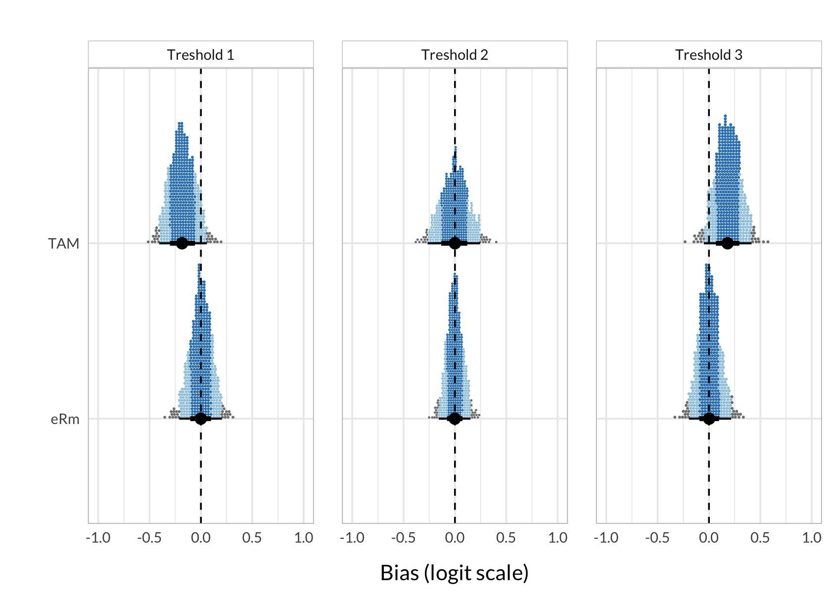
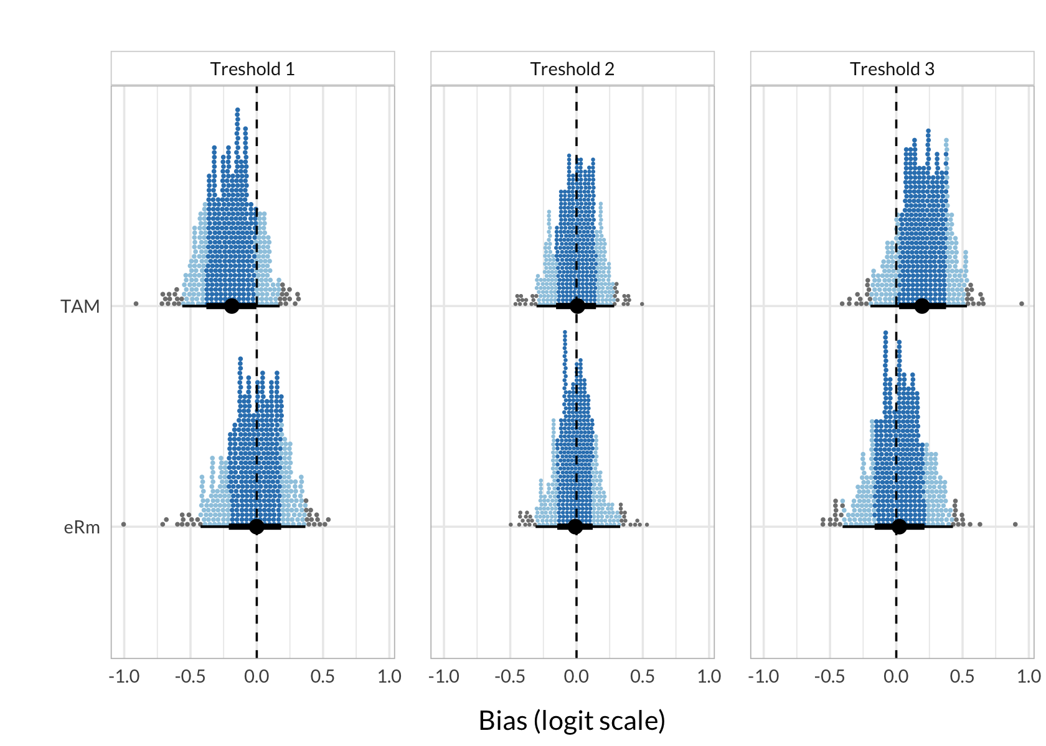
Varying number of items (100 samples)
18 items (n = 1080)
5 items (n = 300)
magnus.p.johansson@ri.se

Slide 19
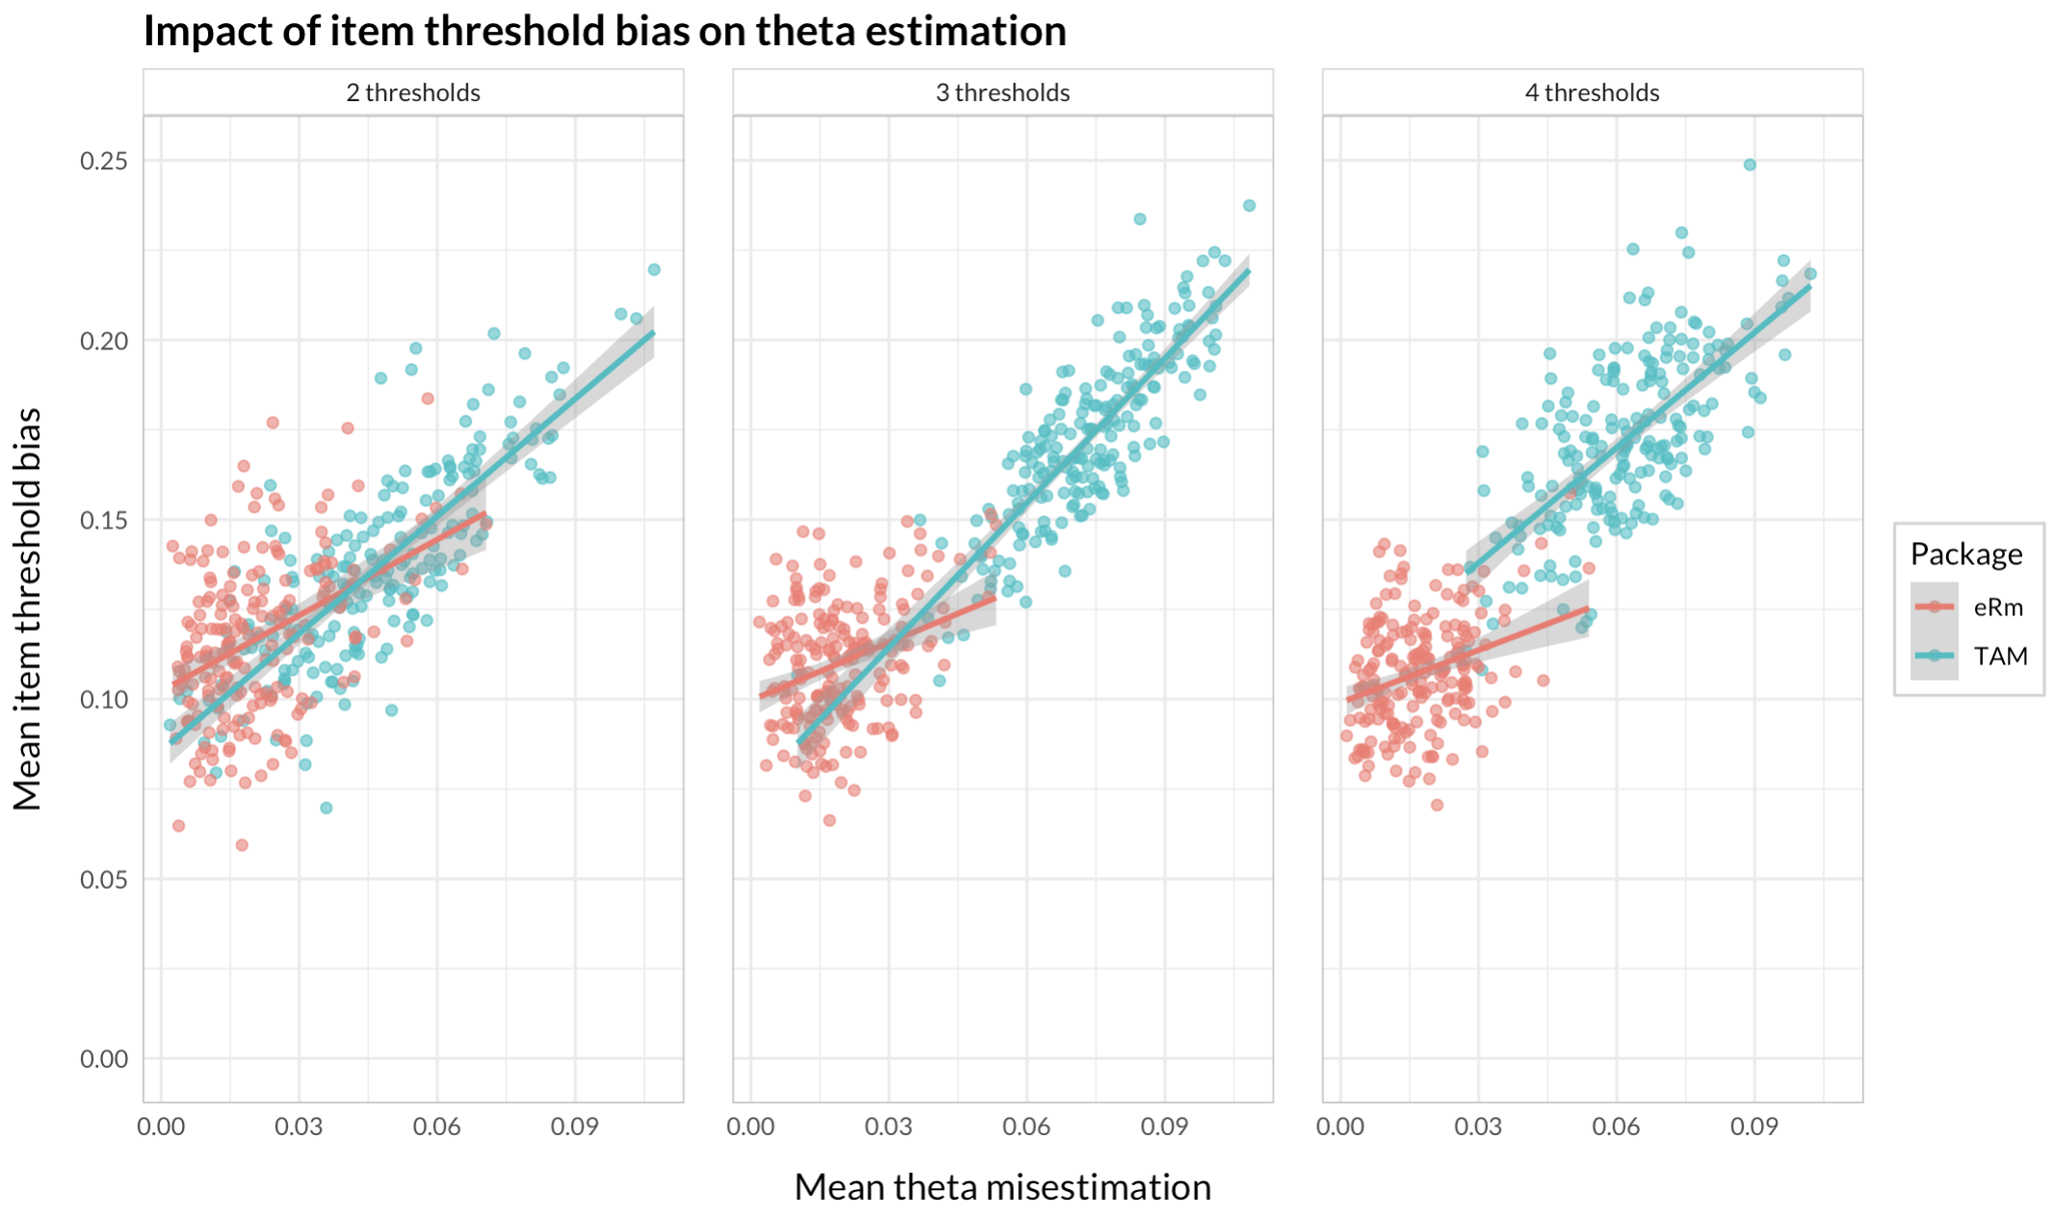
magnus.p.johansson@ri.se

Slide 20
Practical consequences?
Simulated longitudinal data, 3 time points, 2 groups of n = 100. Both groups have a theta mean value at time 1 at -0.6 logits
Improvement in “intervention group” = 0.6 logits per time unit
Improvement in “control group” = 0.2 logits per time unit
Intra-cluster correlation (ICC) for ID (individual) = 0.5
Linear Mixed Model with random intercepts and slopes for ID
3 models, comparing estimated thetas (based on item parameters from input, eRm and TAM)
RISE — Research Institutes of Sweden – Magnus Johansson, PhD – magnus.p.johansson@ri.se

Slide 21
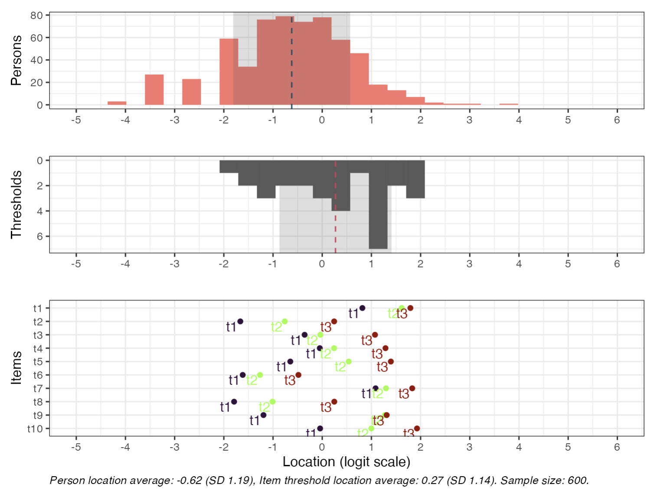
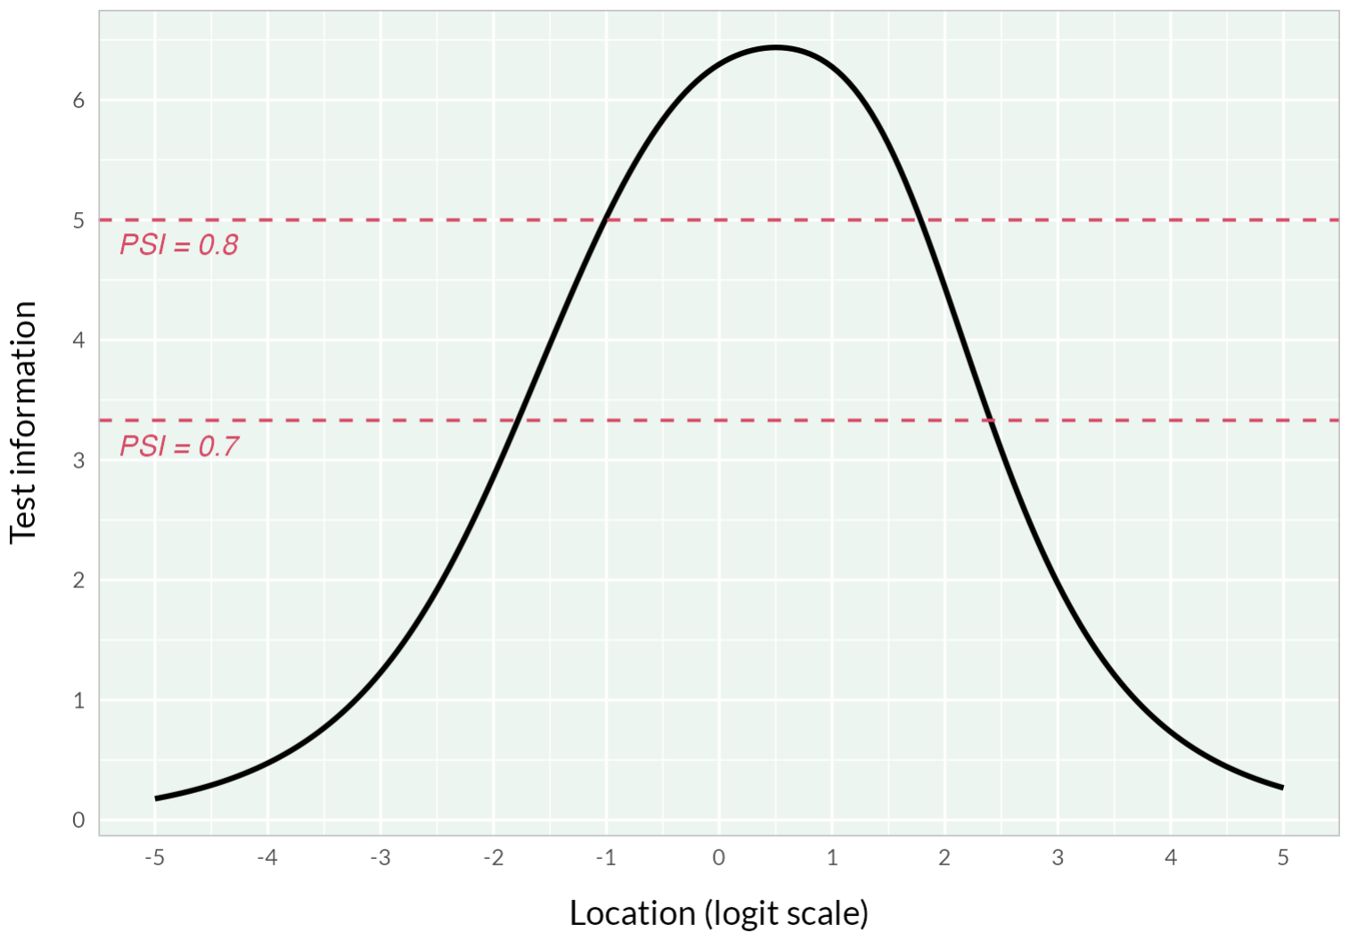
library(lme4)
lmer(input_thetas ~ time * group + (1 + time | id),
data = d_long)

Slide 22
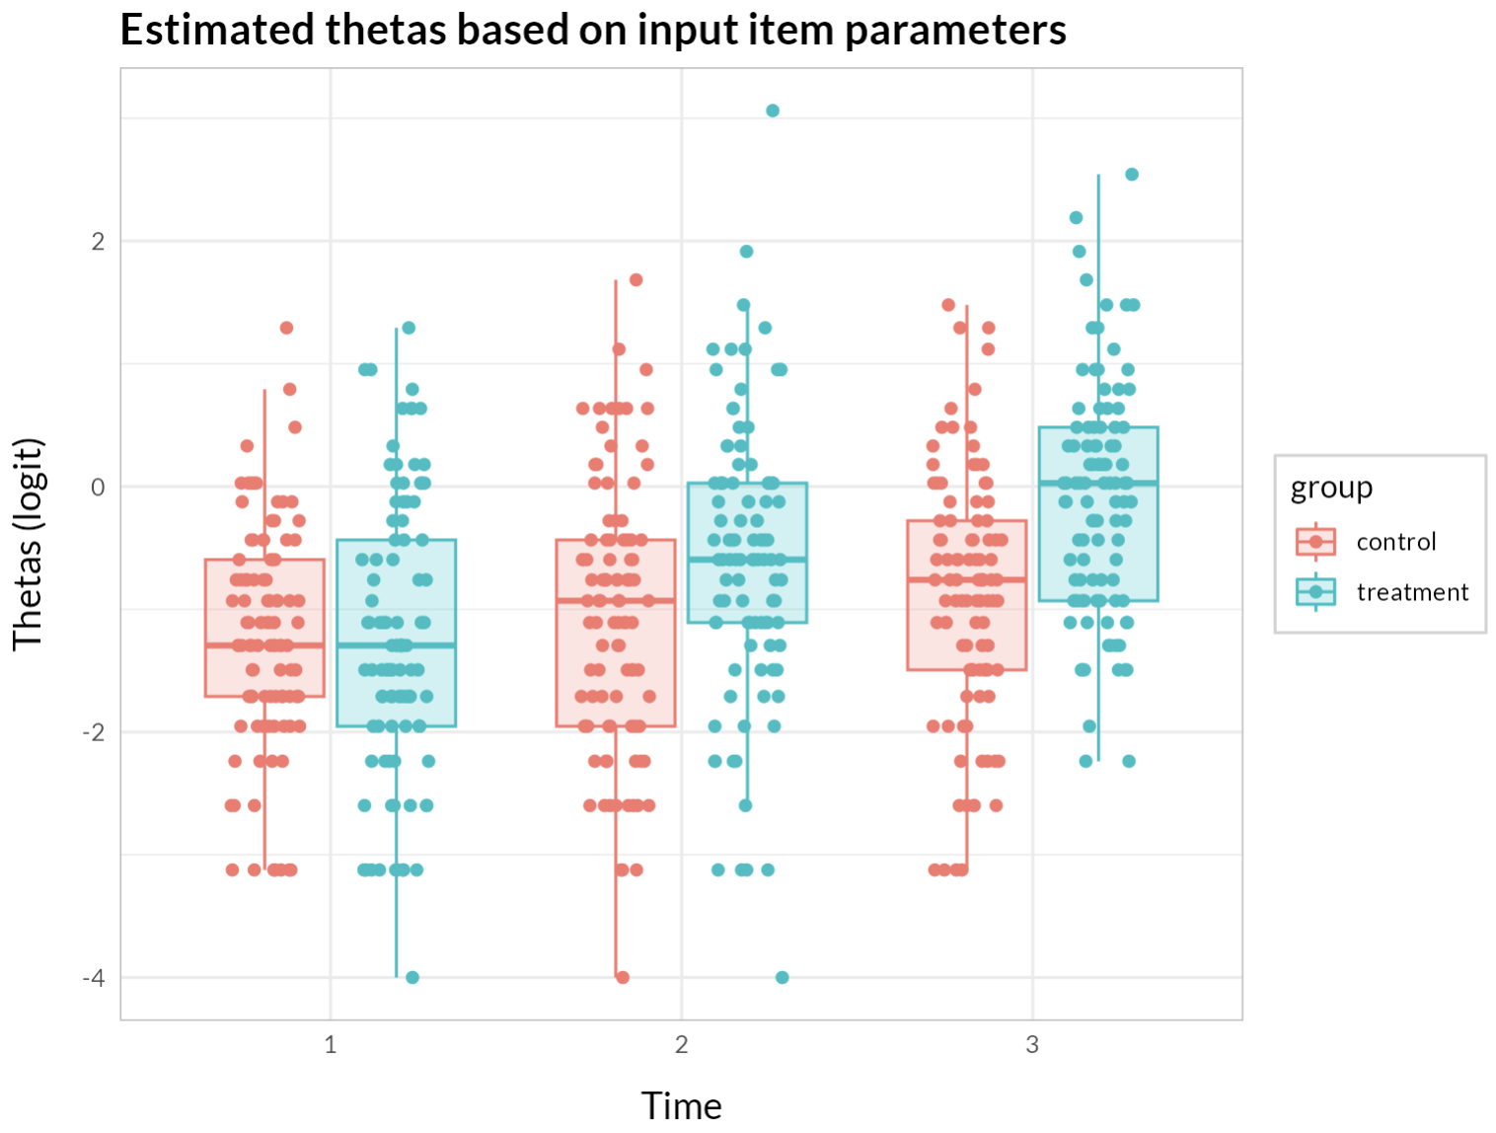

Slide 23
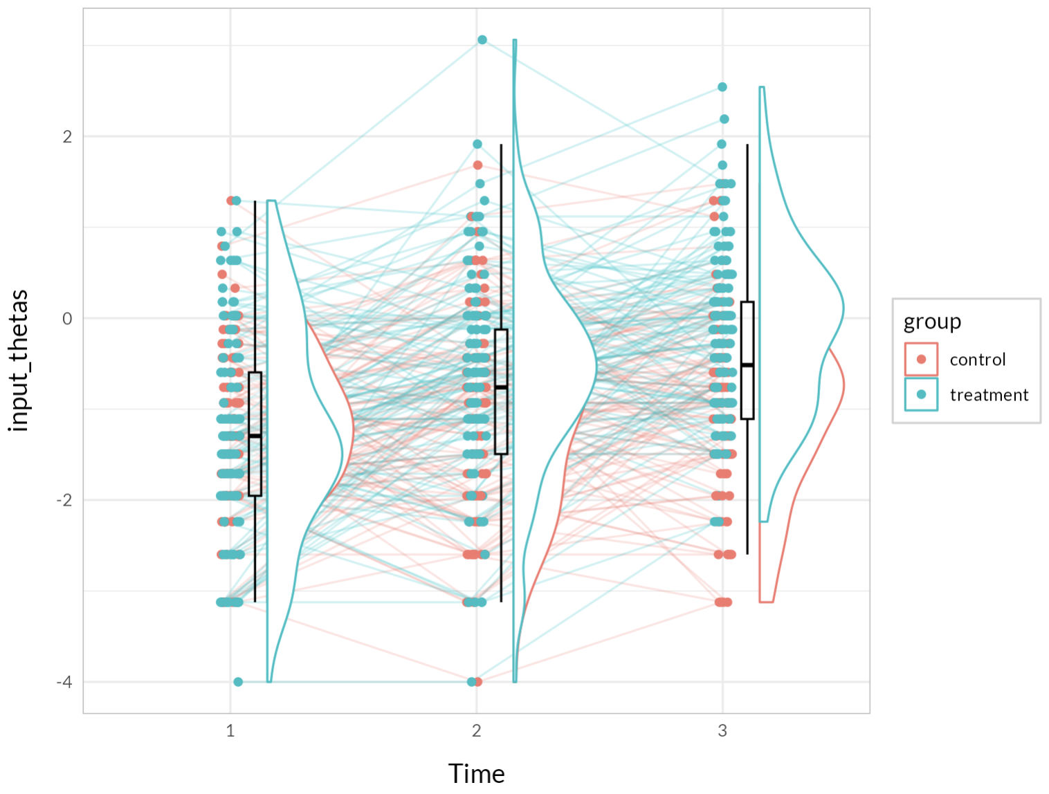

Slide 24
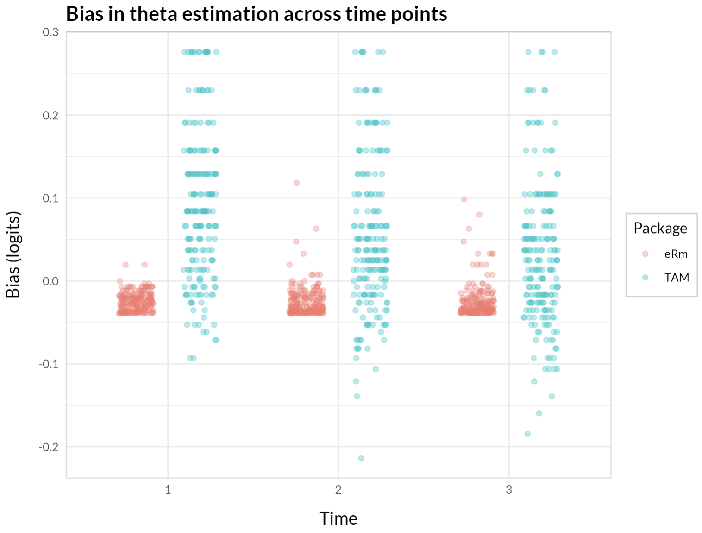

Slide 25
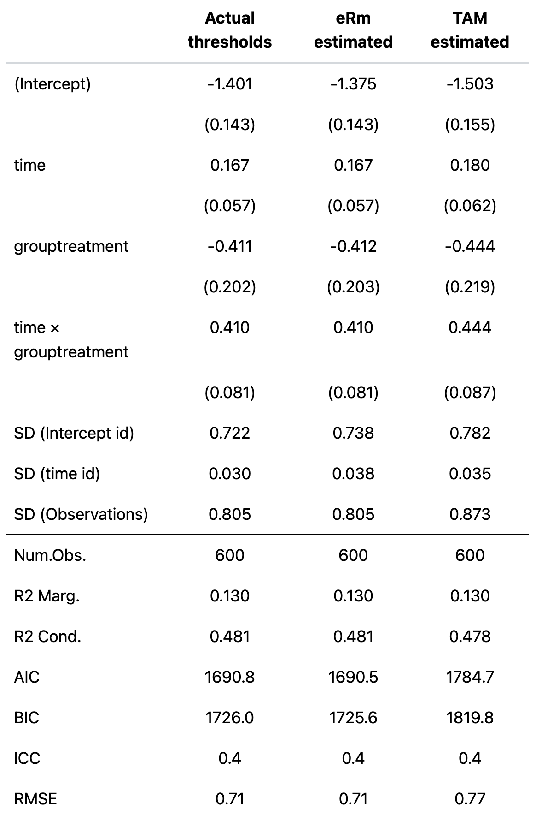
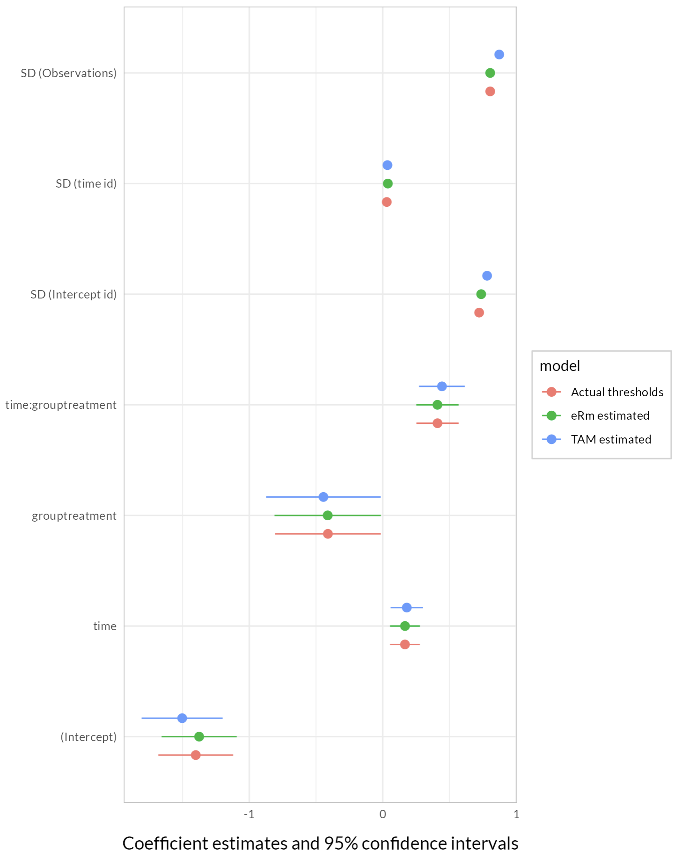

Slide 26
Magnus Johansson
magnus.p.johansson@ri.se

